Slide 1
UML SIMPLE

Slide 2
Class Diagram
Classes are defined from a problem often by looking for “nouns”
Class diagrams contain 3 levels, Class name, Data members, Methods
Class diagrams are connected to other classes with a line.
Default line indicates communication in both directions
Arrow line indicates one way communication between classes
A line often has a number next to the class which indicates the number of a class relative to another class (Car has-a Wheel: Car(1)->Wheel(4)

Slide 3
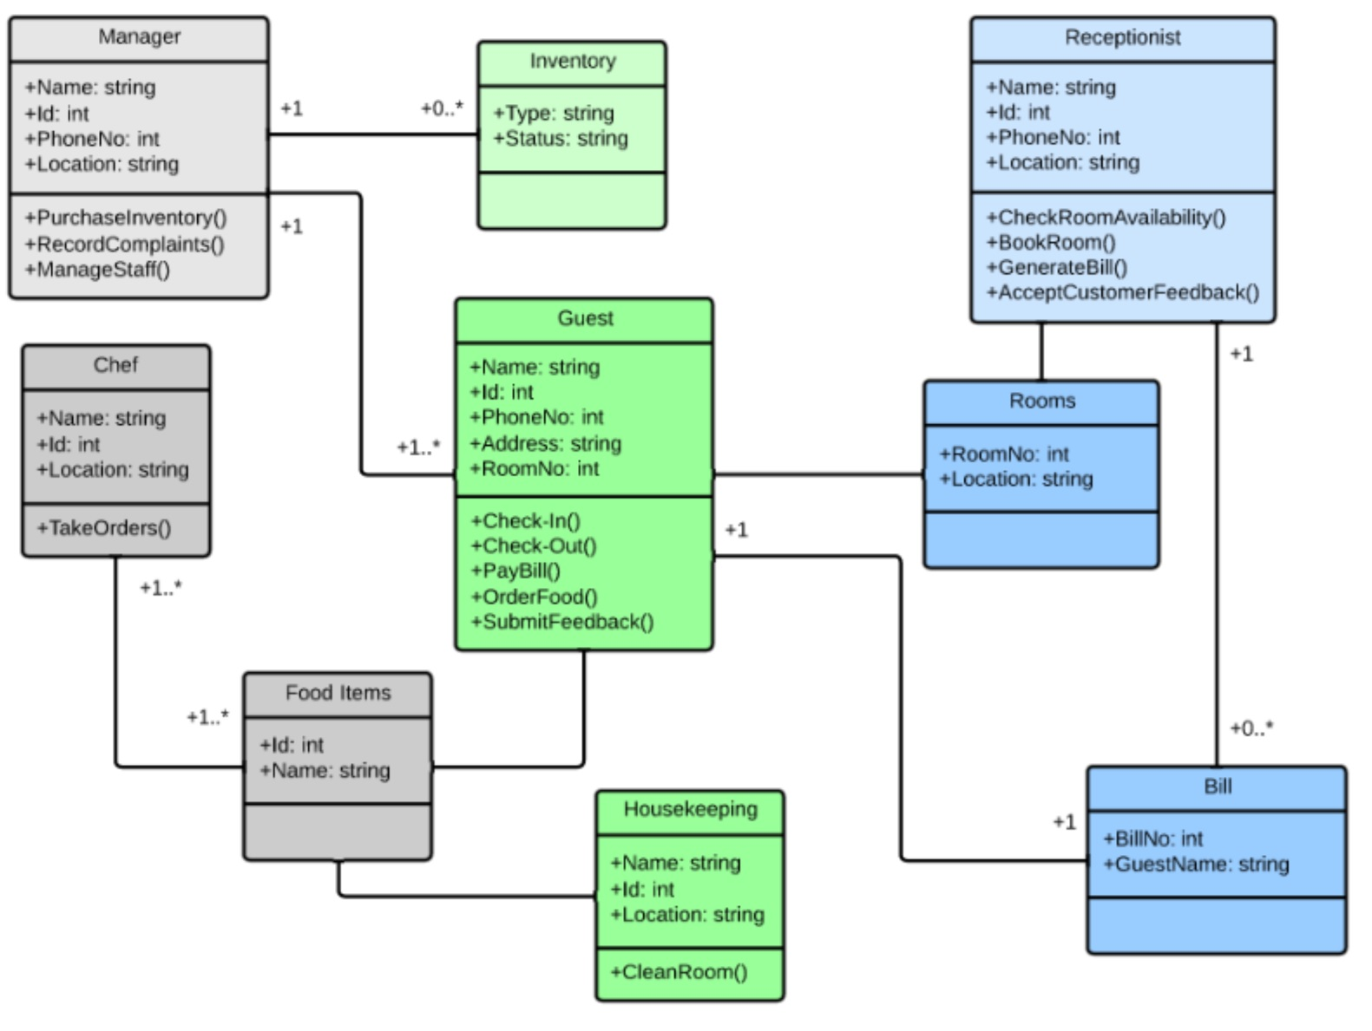

Slide 4
Sequence Diagram
Shows the order things interact to process something
Time of interaction (and thus order) is from top to bottom
Direction of action is shown by arrow direction
Stick person indicates a user or another system
Boxes indicate major system components
Gives the “big picture” of how an interaction is processed

Slide 5
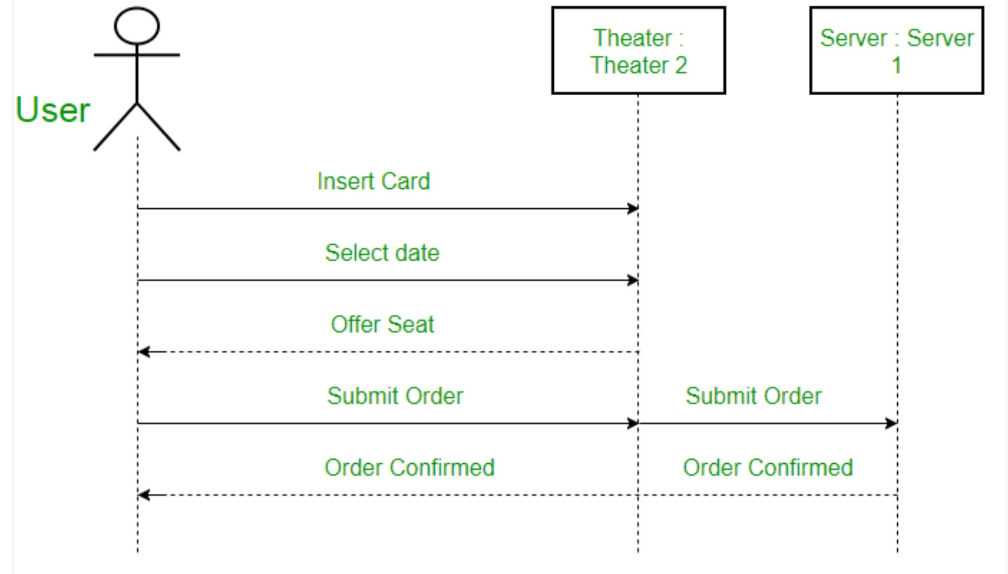

Slide 6
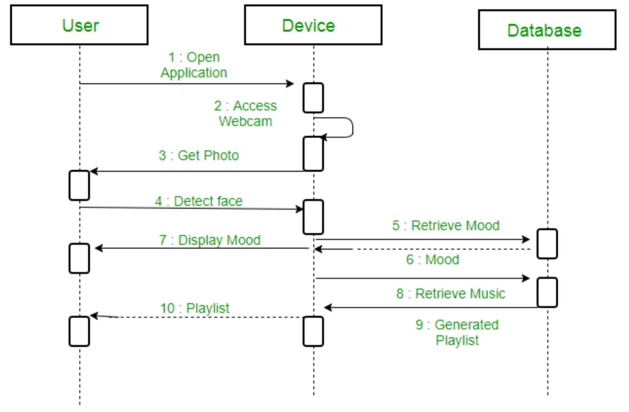

Slide 7
Collaboration aka Communication diagram
shows the objects and relationships involved in an interaction, and the sequence of messages exchanged among the objects during the interaction.
Similar to sequence diagrams but timing not as clear, focus on methods and their sequence of communication with other objects methods
Stick figure is usually a user or another system
Used more in design of objects and methods while Sequence Diagrams are used more with final User/Client while defining the system that will be developed

Slide 8
